Slide 1
HONOR OF PIRATES
Li Jiahao
Li Shujie
Lu Xiao
Group 5
Notes:
honor of pirates
In a world without gold, we might have been heroes. ---Edward Teach
(此人是黑胡子（艾德·萨奇 Edward Teach）是一个虚拟人物，是游戏《刺客信条4》中人物。
黑胡子拿索的海盗船长之一。原型为历史上真实存在的海盗爱德华·蒂奇。)
presentation要求
1. Sketch the world
- how to win/loose/get points
- why is this fun
- Hero
- how to control
- how to die
- Enemy
- default behavior
- special behavior
- background
- what are they /how do they interact

Slide 2
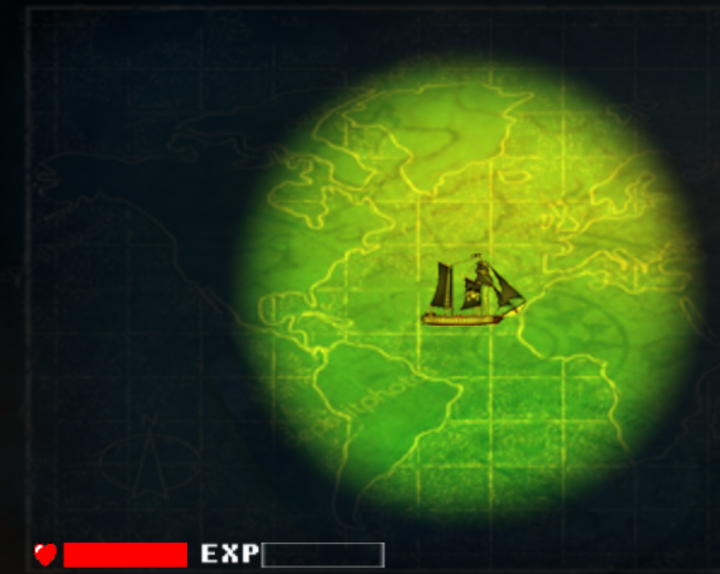
Difficulties in technology
1.How to implement collision
Bound or Pixel?
2.How to implement illumination in different level?
Changed constant in level2 and Win.
We have created many new objects.
3.SuperBullet can shoot in 3 directions
Notes:
欢迎成为pirate

Slide 3
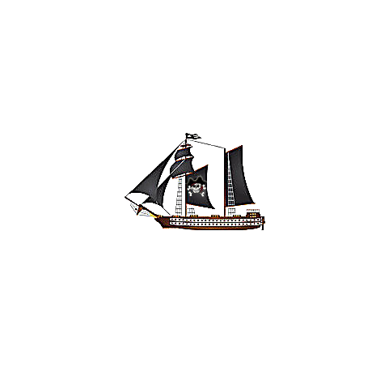
Hero
When you shoot, ship should turn in proper direction.(We use parameter )
We decide not to use other keys to control shoot direction, because our ship will look like strange in this case.
After updating, we can use “press” not click to shot!(to use coldtime!)
Notes:
用WASD控制方向，用空格键来发射炮弹（此时有短暂音效“fire！“【如果后期调试不好，可不用这个】）
通过小窗口看的更清楚（放大）
获得足够的EXP，获得称号：海盗王

Slide 4
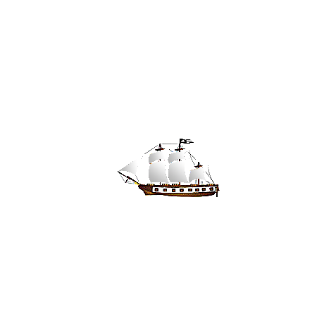
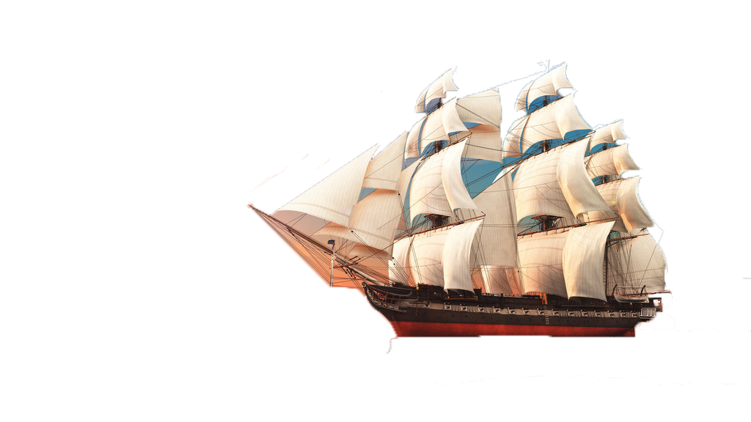
Enemy
1. Royal Navy (proactive attacker)
They can aim at you, and we let them to purse you in random area.
Notes:
Fire at merchant ships and sink them, you will get a certain mount of experience point (EXP).
被动攻击者 Passive Adversarypassive attacker
Elude the ships of Royal Navy. OR bombard and sink them, you will also get EXP.
主动性攻击者 proactive aggressor

Slide 5
THANKS FOR LISTENING
Image from the Internet:
www.nipic.com
www.58pic.com
Notes:
When other men blindly follow the truth,
Remember，Nothing is true.
When other men are limited, by morality or law,
Remember，Everything is permitted.
We work in the dark to serve the light.
当其他人盲目的追寻真相和真实的时候，记住，万物皆虚。
当其他人受到法律和道德的束缚的时候，记住，万事皆允。
我们服侍光明却耕耘于黑暗。

